Slide 1
United College of Engineering and Research, Prayagraj
Voucher Mart
Using Machine learning & Algo
G- 50: VIVEK VISHWAKARMA ANUPAM SHUKLA
PROJECT MENTOR: MR.SANJAY PANDEY

Slide 2
STREAMLINING TRANSACTIONS:
EXPLORING THE
VOUCHER SELLING AND
PURCHASING PLATFORM

Slide 3
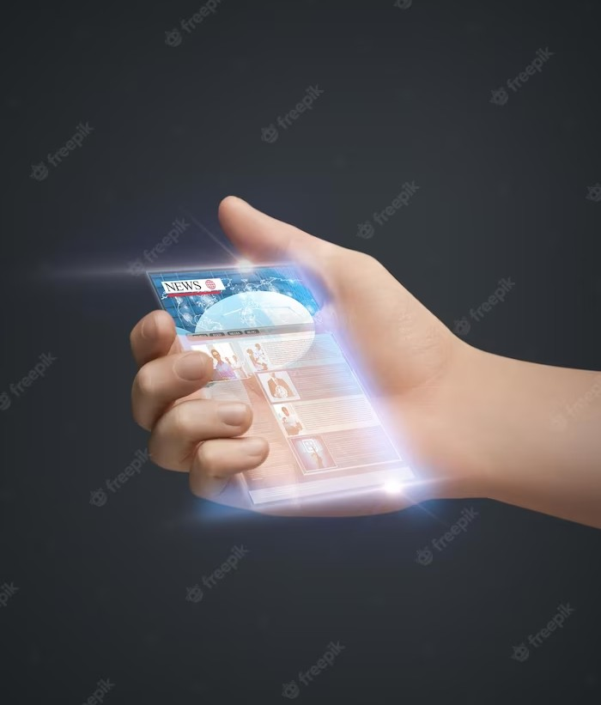
INTRODUCTION
Welcome to the presentation on Streamlining Transactions: Exploring the Voucher Selling and Purchasing Platform. This presentation will delve into the beneﬁts and features of the platform that aims to simplify voucher transactions. We will explore how it enhances convenience, security, and efﬁciency for both sellers and buyers.

Slide 4

CURRENT CHALLENGES
In the current voucher selling and purchasing process, there are several challenges that hinder efﬁciency. These include fragmentation,security issues,fraud and scams,custumer trust , lack of transparency, and time-consuming veriﬁcation. This slide will discuss the pain points faced by both sellers and buyers, highlighting the need for a streamlined platform.

Slide 5

PLATFORM FEATURES
Our voucher selling and purchasing platform offers a range of features to streamline transactions. These include automated voucher generation, real-time tracking, and secure payment integration. This slide will provide an overview of the key features that enhance convenience and efﬁciency for all parties involved.

Slide 6
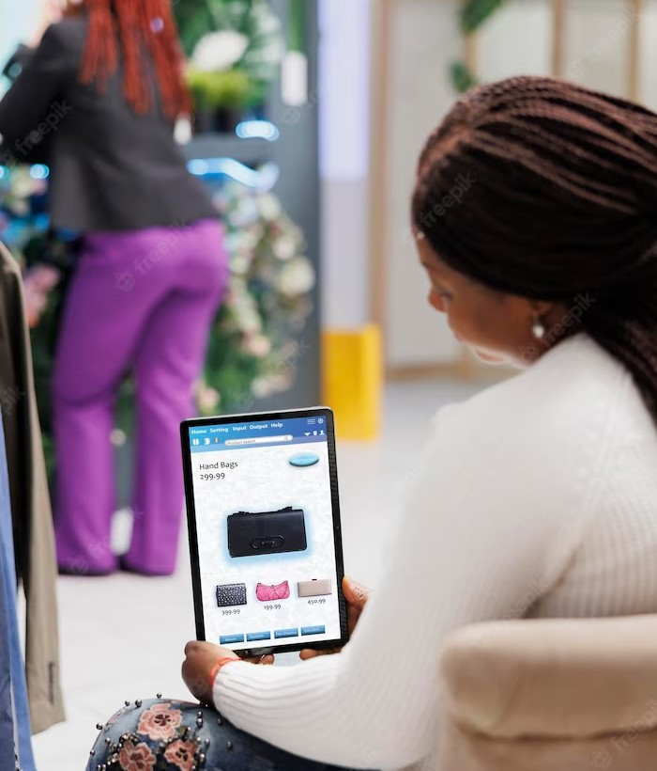
BENEFITS FOR SELLERS
Sellers using our platform experience numerous beneﬁts. They can easily create and manage vouchers, reach a wider audience, and reduce administrative overhead. This slide will explore how the platform empowers sellers to optimize their voucher selling process and maximize their revenue.

Slide 7

Beneﬁts for Buyers
Buyers also enjoy signiﬁcant advantages when using our platform. They can browse and purchase vouchers with ease, access exclusive deals, and enjoy enhanced security. This slide will highlight how the platform enhances the overall buying experience and provides added value to customers.

Slide 8
CONCLUSION
In conclusion, the voucher selling and purchasing platform offers a streamlined solution that addresses the challenges faced by both sellers and buyers. By leveraging automation, real-time tracking, and secure payment integration, the platform revolutionizes voucher transactions, enhancing convenience, efﬁciency, and security. Embrace this platform to unlock the full potential of your voucher- based business.

Slide 9

Thanks!
VIVEK VISHWAKARMA ANUPAM SHUKLA
Group 50

